Slide 1
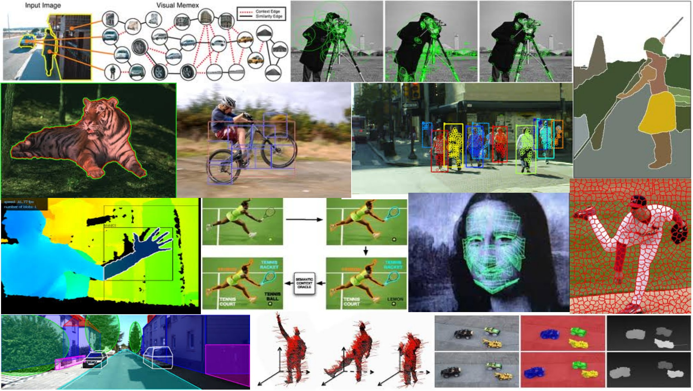
Local features and image matching May 8th, 2018
Yong Jae Lee
UC Davis

Slide 2
Last time
RANSAC for robust fitting
Lines, translation
Image mosaics
Fitting a 2D transformation
Homography

Slide 3


Today
Mosaics recap:
How to warp one image to the other, given H?
How to detect which features to match?

Slide 4
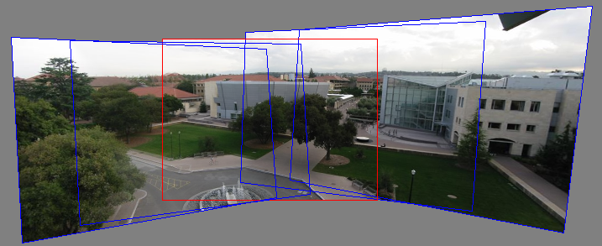
Motivation for feature-based alignment: Image mosaics
Image from http://graphics.cs.cmu.edu/courses/15-463/2010_fall/

Slide 5
Projective Transformations
Projective transformations:
Affine transformations, and
Projective warps
Parallel lines do not necessarily remain parallel

Slide 6
How to stitch together a panorama (a.k.a. mosaic)?
Basic Procedure
Take a sequence of images from the same position
Rotate the camera about its optical center
Compute transformation between second image and first
Transform the second image to overlap with the first
Blend the two together to create a mosaic
(If there are more images, repeat)
Source: Steve Seitz

Slide 7
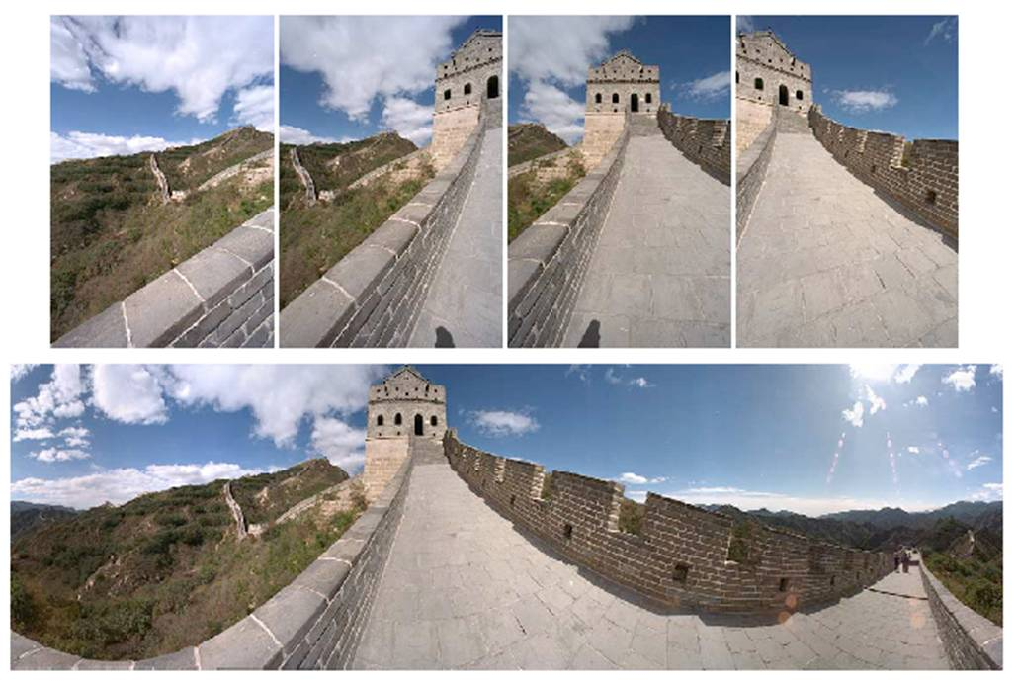
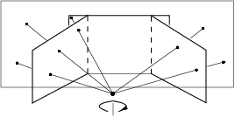
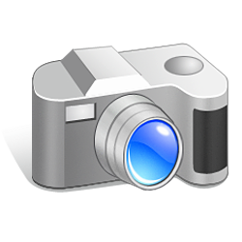
Mosaics
. . .
image from S. Seitz
Obtain a wider angle view by combining multiple images.

Slide 8
How to stitch together a panorama (a.k.a. mosaic)?
Basic Procedure
Take a sequence of images from the same position
Rotate the camera about its optical center
Compute transformation between second image and first
Transform the second image to overlap with the first
Blend the two together to create a mosaic
(If there are more images, repeat)
…but wait, why should this work at all?
What about the 3D geometry of the scene?
Why aren’t we using it?
Source: Steve Seitz

Slide 9
Image reprojection
Basic question
How to relate two images from the same camera center?
how to map a pixel from PP1 to PP2
PP2
Answer
Cast a ray through each pixel in PP1
Draw the pixel where that ray intersects PP2
Observation:
Rather than thinking of this as a 3D reprojection, think of it as a 2D image warp from one image to another.
PP1
Source: Alyosha Efros

Slide 10
Image reprojection: Homography
A projective transform is a mapping between any two PPs with the same center of projection
rectangle should map to arbitrary quadrilateral
parallel lines aren’t preserved
but must preserve straight lines
called Homography
PP2
PP1
p’
H
p
Source: Alyosha Efros

Slide 11
Homography
…
…
To compute the homography given pairs of corresponding points in the images, we need to set up an equation where the parameters of H are the unknowns…

Slide 12
Solving for homographies
p’ = Hp
Defined up to a scale factor.
Constrain Frobenius norm of H to be 1.
Problem to be solved:
where vector of unknowns h = [h₀₀,h₀₁,h₀₂,h₁₀,h₁₁,h₁₂,h₂₀,h₂₁,h₂₂]^{T}
Adapted from Devi Parikh
Notes:
There is a whole set of solution homographies with variation across scale that represent the same geometrical transformation

Slide 13
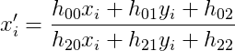
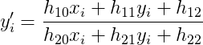
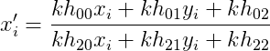
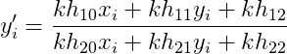
Solving for homographies
There are 9 variables h₀₀,…,h₂₂.
Are there 9 degrees of freedom?
No. We can multiply all h_{ij} by nonzero scalar k without changing the equations:
Notes:
There is a whole set of solution homographies with variation across scale that represent the same geometrical transformation
DOF: number of variables that are free to vary

Slide 14
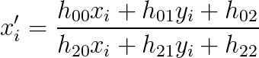

Enforcing 8 DOF
Impose unit vector constraint
Subject to:
Notes:
However, if h_22=0 this approach fails
Also poor results if h_22 close to zero; thus, not recommended

Slide 15
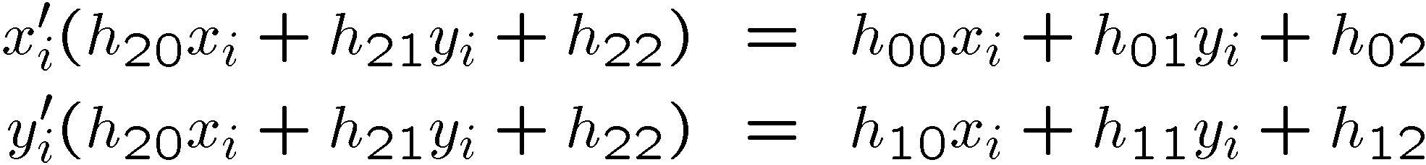
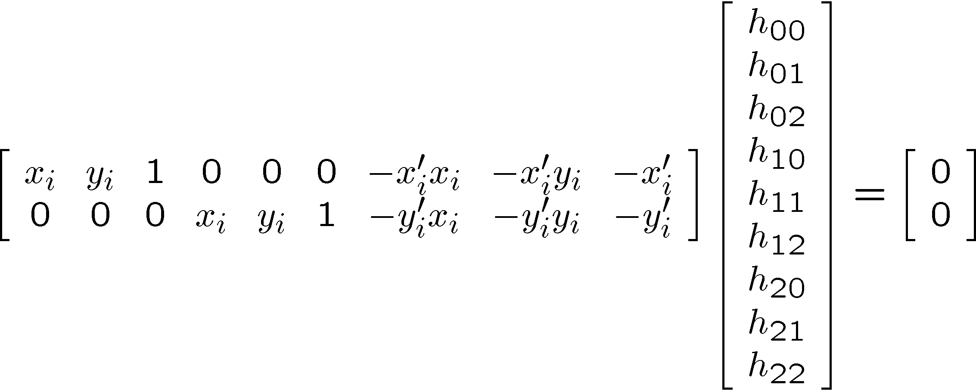
Solving for homographies

Slide 16
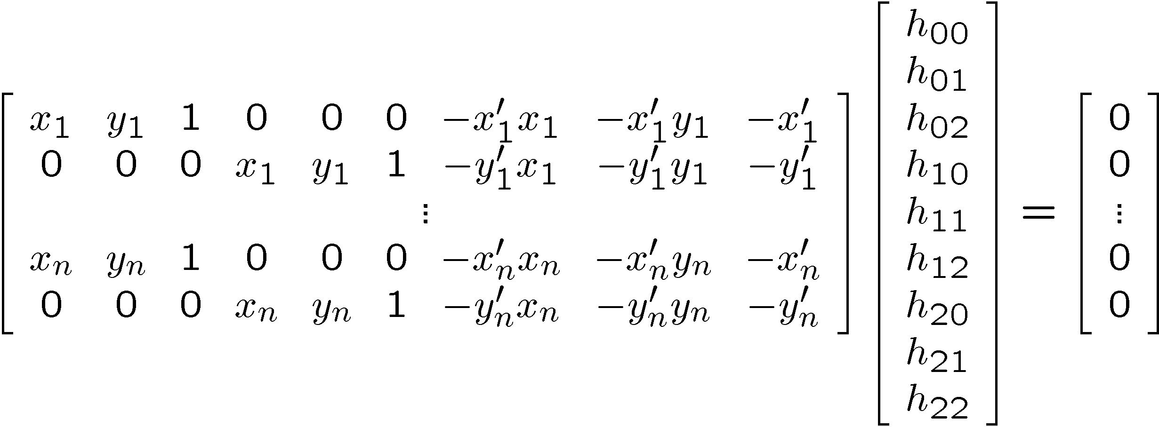

Solving for homographies
A
h
0
2n × 9
9
2n
Defines a least squares problem:
Since h is only defined up to scale, solve for unit vector ĥ
Solution: ĥ = eigenvector of A^{T}A with smallest eigenvalue
Works with 4 or more points

Slide 17
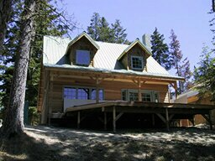
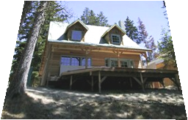
Projective: # correspondences?
?
T(x,y)
y
y’
x
x’
How many correspondences needed for projective?
Source: Alyosha Efros

Slide 18
Homography
To apply a given homography H
Compute p’ = Hp (regular matrix multiply)
Convert p’ from homogeneous to image coordinates
p’
H
p
Slide credit: Kristen Grauman

Slide 19
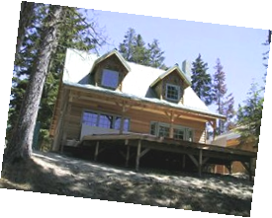
Image warping
T(x,y)
y
y’
x
x’
f(x,y)
g(x’,y’)
Given a coordinate transform and a source image f(x,y), how do we compute a transformed image g(x’,y’) = f(T(x,y))?
Slide from Alyosha Efros, CMU

Slide 20
Forward warping
T(x,y)
y
y’
x
x’
f(x,y)
g(x’,y’)
Send each pixel f(x,y) to its corresponding location
(x’,y’) = T(x,y) in the second image
Q: what if pixel lands “between” two pixels?
Slide from Alyosha Efros, CMU

Slide 21
Forward warping
T(x,y)
y
y’
x
x’
f(x,y)
g(x’,y’)
Send each pixel f(x,y) to its corresponding location
(x’,y’) = T(x,y) in the second image
Q: what if pixel lands “between” two pixels?
A: distribute color among neighboring pixels (x’,y’)
Known as “splatting”
Slide from Alyosha Efros, CMU

Slide 22
Inverse warping
T⁻¹(x,y)
y
y’
x
x
x’
f(x,y)
g(x’,y’)
Get each pixel g(x’,y’) from its corresponding location
(x,y) = T⁻¹(x’,y’) in the first image
Q: what if pixel comes from “between” two pixels?
Slide from Alyosha Efros, CMU

Slide 23
Inverse warping
T⁻¹(x,y)
y
y’
x
x
x’
f(x,y)
g(x’,y’)
Get each pixel g(x’,y’) from its corresponding location
(x,y) = T⁻¹(x’,y’) in the first image
Q: what if pixel comes from “between” two pixels?
A: Interpolate color value from neighbors
nearest neighbor, bilinear…
Slide from Alyosha Efros, CMU

Slide 24





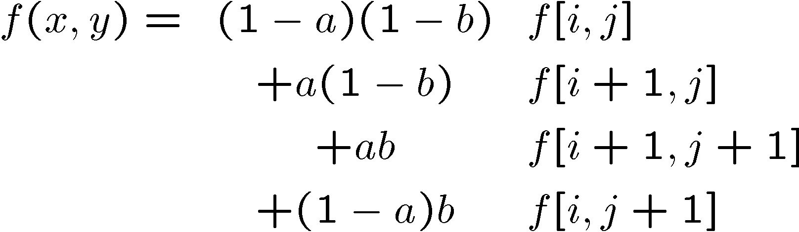
Bilinear interpolation
Sampling at f(x,y):
Slide from Alyosha Efros, CMU

Slide 25
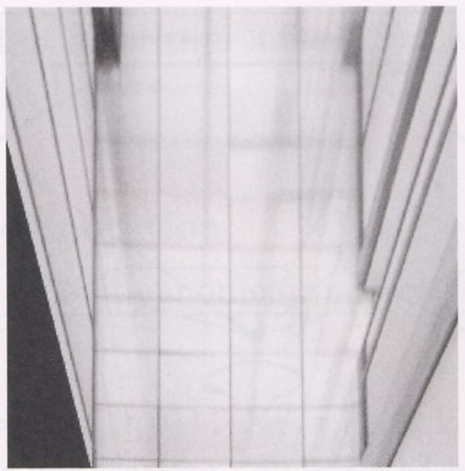
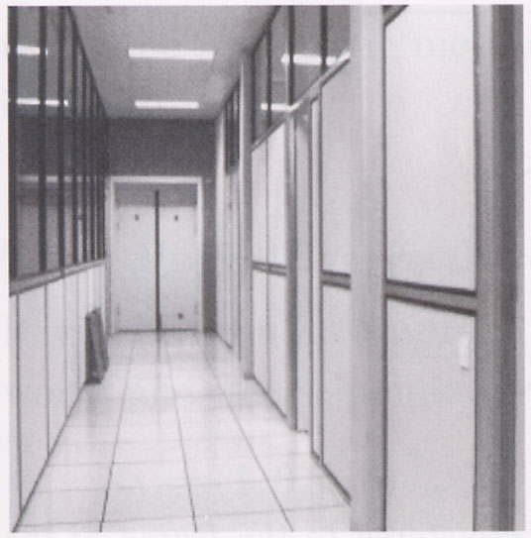
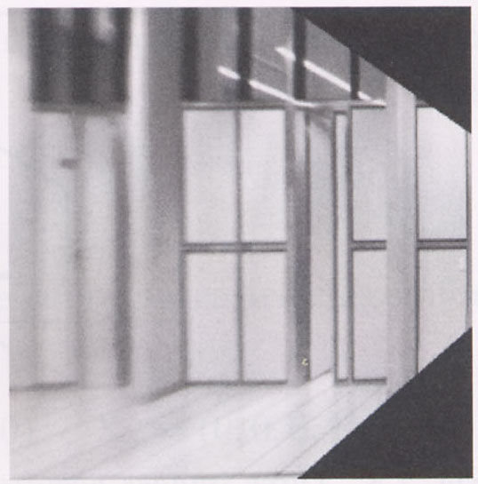
Image warping with homographies
image plane in front
image plane below
black area
where no pixel
maps to
Source: Steve Seitz

Slide 26
Image rectification
p’
p

Slide 27
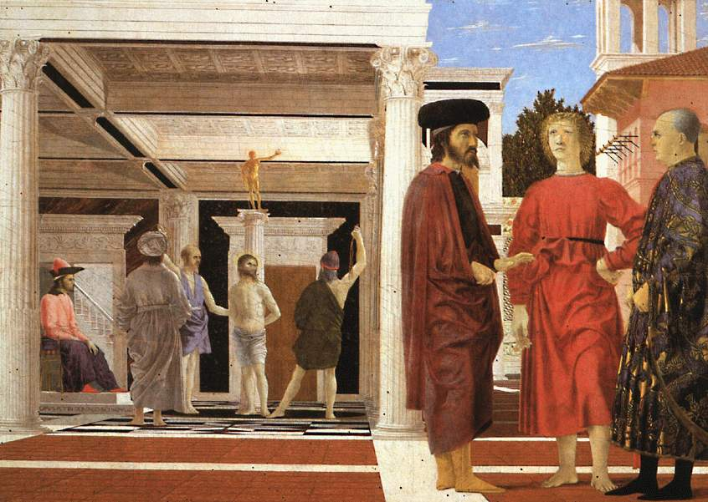
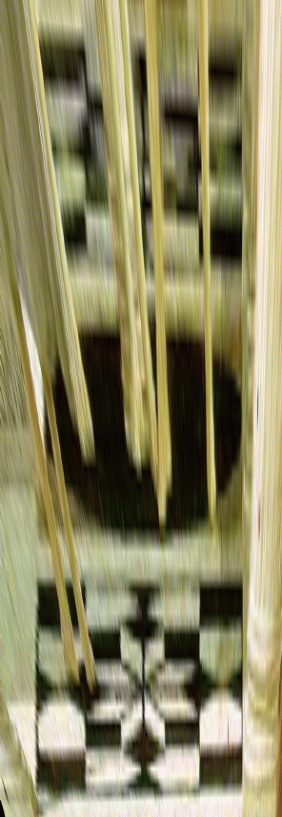
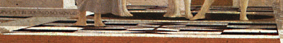
Analysing patterns and shapes
What is the shape of the b/w floor pattern?
Homography
The floor (enlarged)
Automatically
rectified floor
Slide from Antonio Criminisi

Slide 28
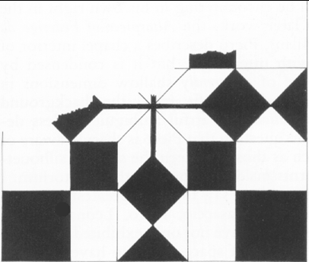
Analysing patterns and shapes
Automatic rectification
From Martin Kemp The Science of Art
(manual reconstruction)
Slide from Antonio Criminisi

Slide 29
Changing camera center
Does it still work?
synthetic PP
PP1
PP2
Source: Alyosha Efros

Slide 30
Recall: same camera center
real
camera
synthetic
camera
Can generate synthetic camera view
as long as it has the same center of projection.
Source: Alyosha Efros

Slide 31
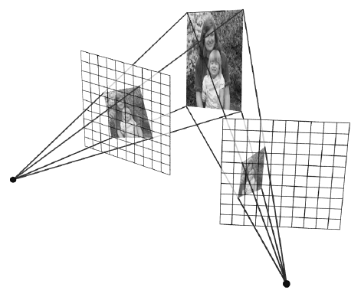
…Or: Planar scene (or far away)
PP3
PP1
PP2
PP3 is a projection plane of both centers of projection, so we are OK!
This is how big aerial photographs are made
Source: Alyosha Efros

Slide 32
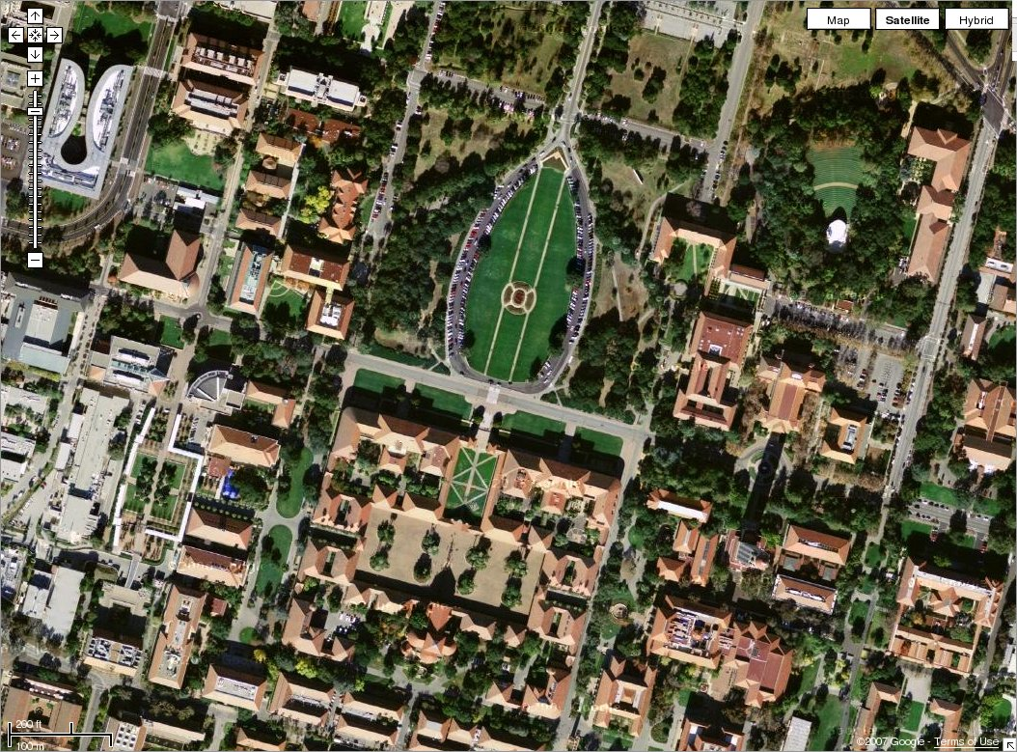

Slide 33
RANSAC for estimating homography
RANSAC loop:
1. Select four feature pairs (at random)
2. Compute homography H (exact)
3. Compute inliers where SSD(p_{i}’, Hp_{i})< ε
4. Keep largest set of inliers
5. Re-compute least-squares H estimate on all of the inliers
Slide credit: Steve Seitz

Slide 34


Robust feature-based alignment
Source: L. Lazebnik

Slide 35
Robust feature-based alignment
Extract features
Source: L. Lazebnik

Slide 36
Robust feature-based alignment
Extract features
Compute putative matches
Source: L. Lazebnik

Slide 37
Robust feature-based alignment
Extract features
Compute putative matches
Loop:
Hypothesize transformation T (small group of putative matches that are related by T)
Source: L. Lazebnik

Slide 38
Robust feature-based alignment
Extract features
Compute putative matches
Loop:
Hypothesize transformation T (small group of putative matches that are related by T)
Verify transformation (search for other matches consistent with T)
Source: L. Lazebnik

Slide 39

Robust feature-based alignment
Extract features
Compute putative matches
Loop:
Hypothesize transformation T (small group of putative matches that are related by T)
Verify transformation (search for other matches consistent with T)
Source: L. Lazebnik

Slide 40
Summary: alignment & warping
Write 2d transformations as matrix-vector multiplication (including translation when we use homogeneous coordinates)
Fitting transformations: solve for unknown parameters given corresponding points from two views (affine, projective (homography)).
Perform image warping (inverse)
Mosaics: uses homography and image warping to merge views taken from same center of projection.

Slide 41
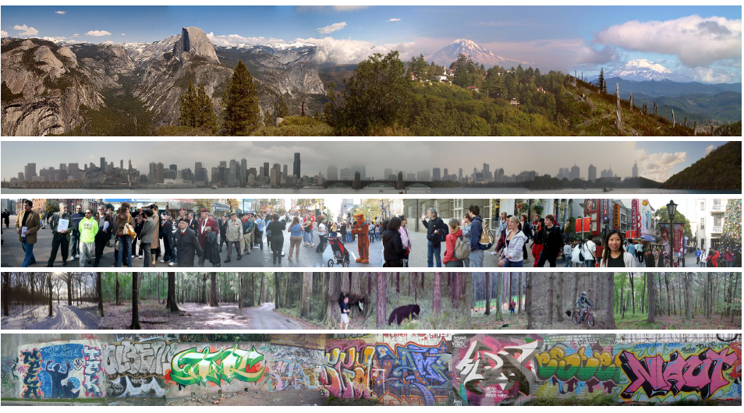
Creating and Exploring a Large Photorealistic Virtual Space
Josef Sivic, Biliana Kaneva, Antonio Torralba, Shai Avidan and William T. Freeman, Internet Vision Workshop, CVPR 2008.
http://www.youtube.com/watch?v=E0rboU10rPo
Notes:
a collection of several million images downloaded from Flickr
broken into themes that consist of a few hundred thousand images each

Slide 42
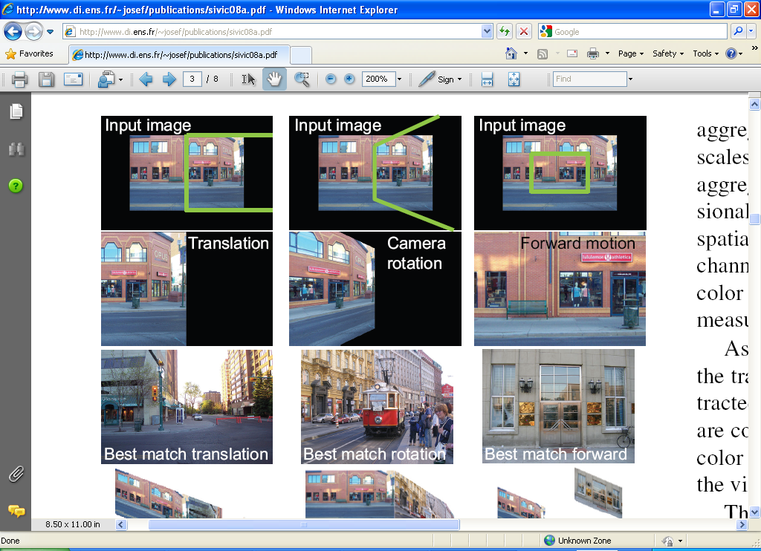
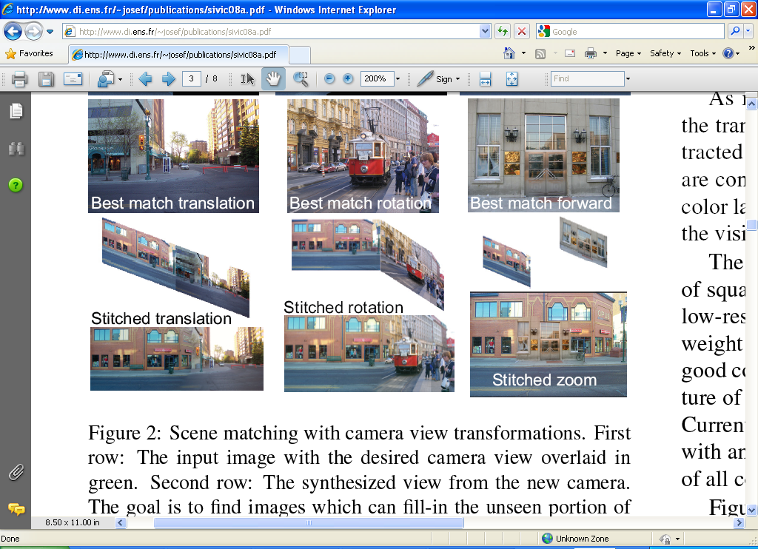
Creating and Exploring a Large Photorealistic Virtual Space
Current view, and desired view in green
Synthesized view from new camera
Induced camera motion
Notes:
Scene matching with camera view transformations.
First row: The input image with the desired camera view overlaid in green.
Second row: The synthesized view from the new camera. The goal is to find images which can fill-in the unseen portion of the image (shown in black) while matching the visible portion.
Third row: the top matching image found in the dataset of street scenes for each motion.
Fourth row: induced camera motion between the two pictures.
Final row: composite after Poisson blending

Slide 43
Today
Mosaics recap:
How to warp one image to the other, given H?
How to detect which features to match?

Slide 44
Detecting local invariant features
Detection of interest points
Harris corner detection
(Scale invariant blob detection: LoG)
(Next time: description of local patches)

Slide 45
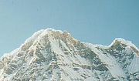
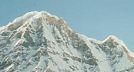
Local features: main components
Detection: Identify the interest points
Description: Extract vector feature descriptor surrounding each interest point.
Matching: Determine correspondence between descriptors in two views
Kristen Grauman
Notes:
3 main components

Slide 46
Local features: desired properties
Repeatability
The same feature can be found in several images despite geometric and photometric transformations
Saliency
Each feature has a distinctive description
Compactness and efficiency
Many fewer features than image pixels
Locality
A feature occupies a relatively small area of the image; robust to clutter and occlusion
Notes:
4 desired properties

Slide 47
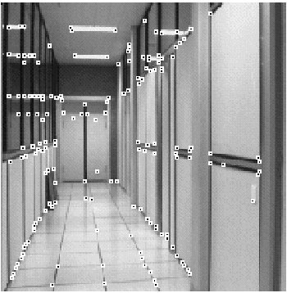
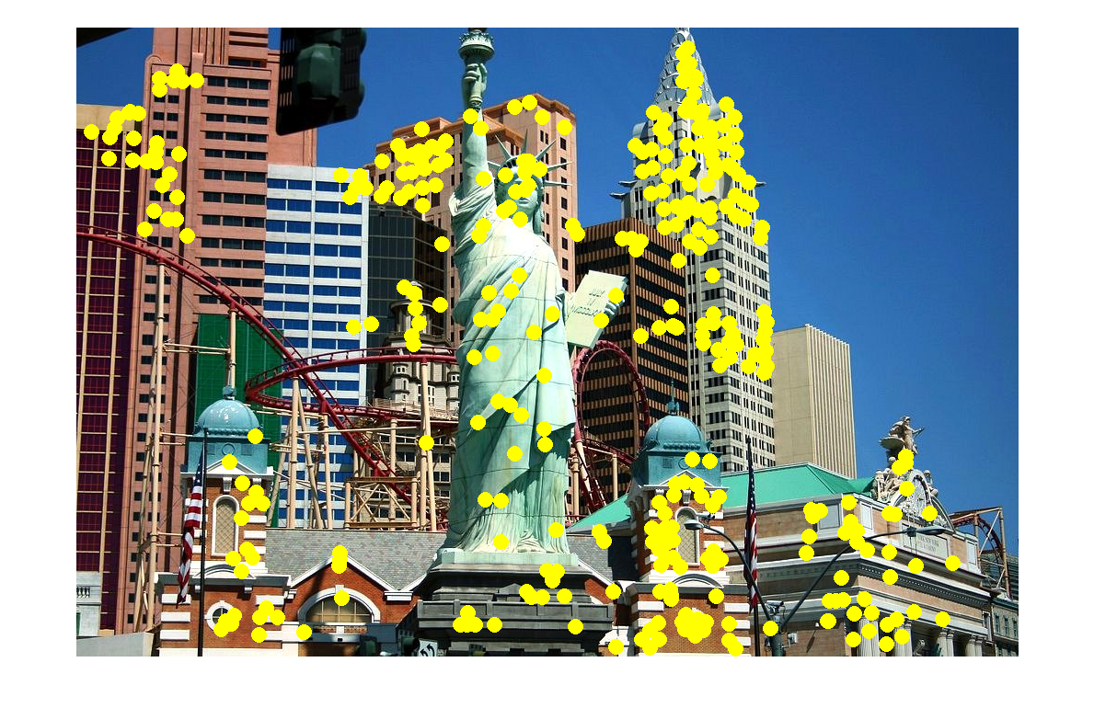
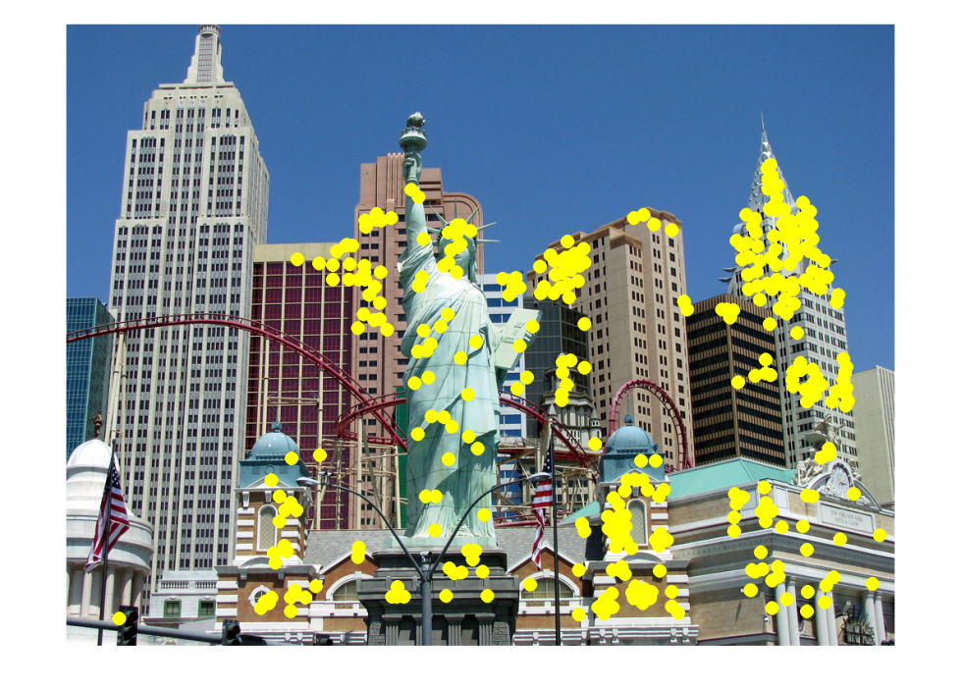
Applications
Local features have be used for:
Image alignment
3D reconstruction
Motion tracking
Robot navigation
Indexing and database retrieval
Object recognition
Lana Lazebnik

Slide 48
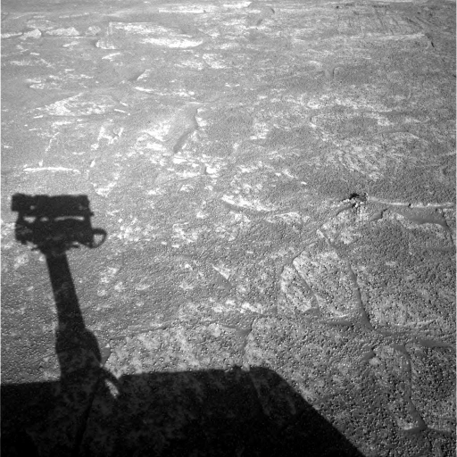
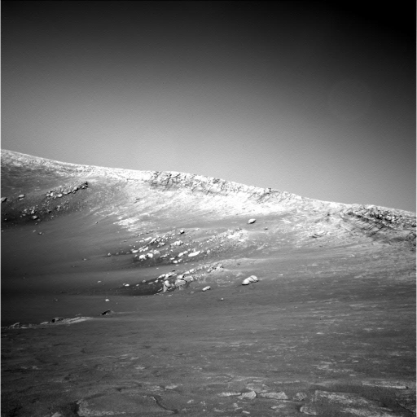
A hard feature matching problem
NASA Mars Rover images

Slide 49
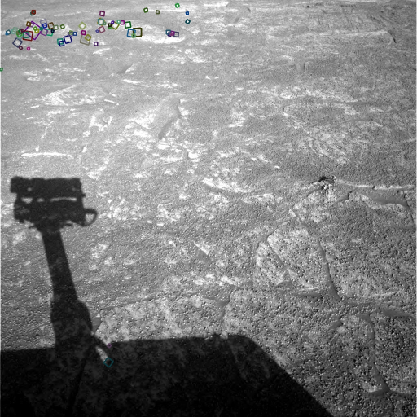
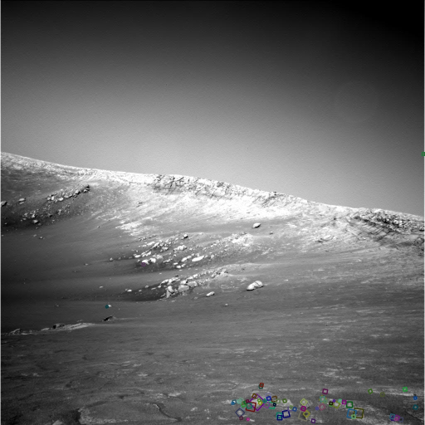
Answer below (look for tiny colored squares…)
NASA Mars Rover images
with SIFT feature matches Figure by Noah Snavely

Slide 50
Goal: interest operator repeatability
We want to detect (at least some of) the same points in both images.
Yet we have to be able to run the detection procedure independently per image.
No chance to find true matches!
Notes:
50

Slide 51
Goal: descriptor distinctiveness
We want to be able to reliably determine which point goes with which.
Must provide some invariance to geometric and photometric differences between the two views.
?

Slide 52
Local features: main components
Detection: Identify the interest points
Description:Extract vector feature descriptor surrounding each interest point.
Matching: Determine correspondence between descriptors in two views

Slide 53
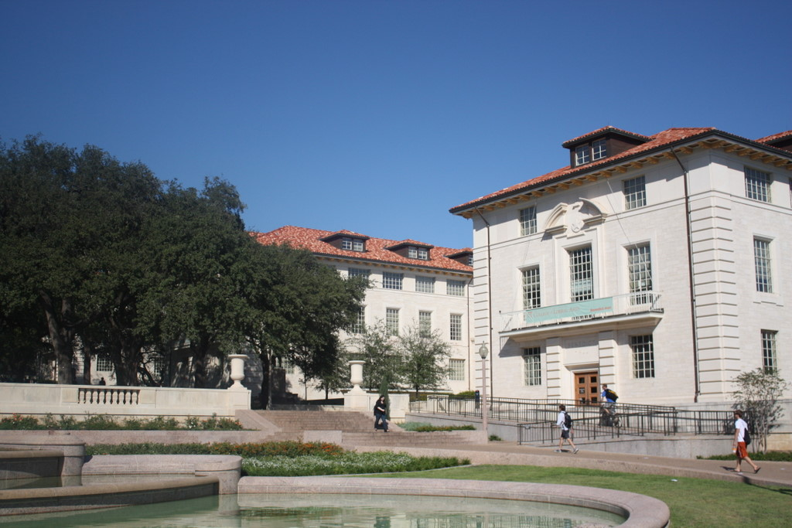
What points would you choose (for repeatability, distinctiveness)?
Notes:
For repeatability, distinctiveness

Slide 54

Corners as distinctive interest points
We should easily recognize the point by looking through a small window
Shifting a window in any direction should give a large change in intensity
“flat” region: no change in all directions
“edge”: no change along the edge direction
“corner”: significant change in all directions
Slide credit: Alyosha Efros, Darya Frolova, Denis Simakov

Slide 55
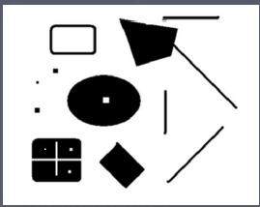
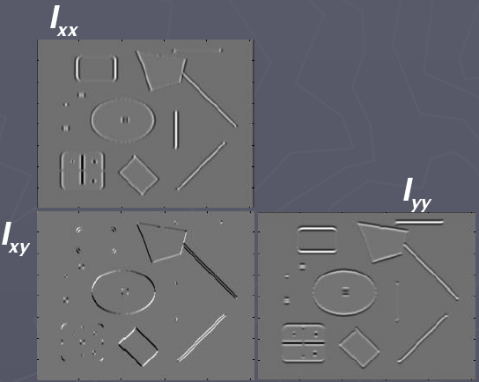
Corners as distinctive interest points
2 x 2 matrix of image derivatives (averaged in neighborhood of a point).
Notation:

Slide 56
What does this matrix reveal?
First, consider an axis-aligned corner:

Slide 57
What does this matrix reveal?
First, consider an axis-aligned corner:
This means dominant gradient directions align with x or y axis
Look for locations where both λ’s are large.
If either λ is close to 0, then this is not corner-like.
What if we have a corner that is not aligned with the image axes?

Slide 58
What does this matrix reveal?
Since M is symmetric, we have
(Eigenvalue decomposition)
The eigenvalues of M reveal the amount of intensity change in the two principal orthogonal gradient directions in the window.
Notes:
rotation

Slide 59
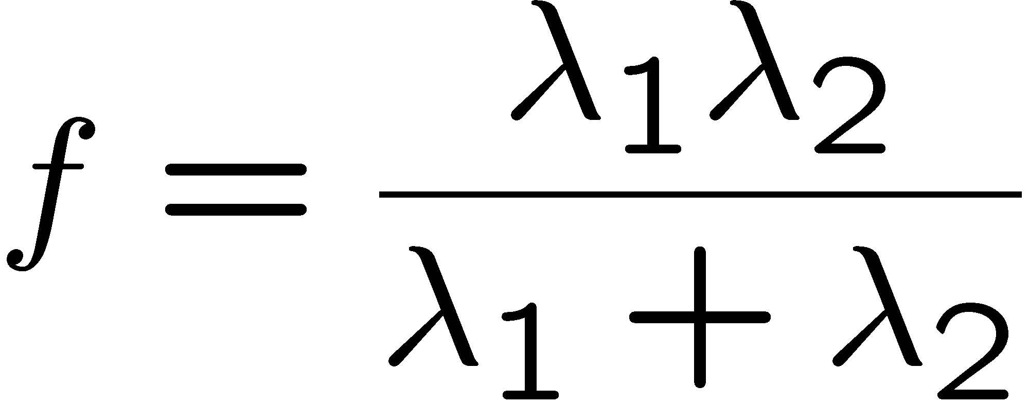
Corner response function
“edge”:
“corner”:
“flat” region
λ₁ >> λ₂
λ₁ and λ₂ are large, λ₁ ~ λ₂;
λ₁ and λ₂ are small;
λ₂ >> λ₁

Slide 60
Harris corner detector
Compute M matrix for each image window to get their cornerness scores.
Find points whose surrounding window gave large corner response (f > threshold)
Take the points of local maxima, i.e., perform non-maximum suppression
Notes:
60

Slide 61
Example of Harris application
Kristen Grauman

Slide 62
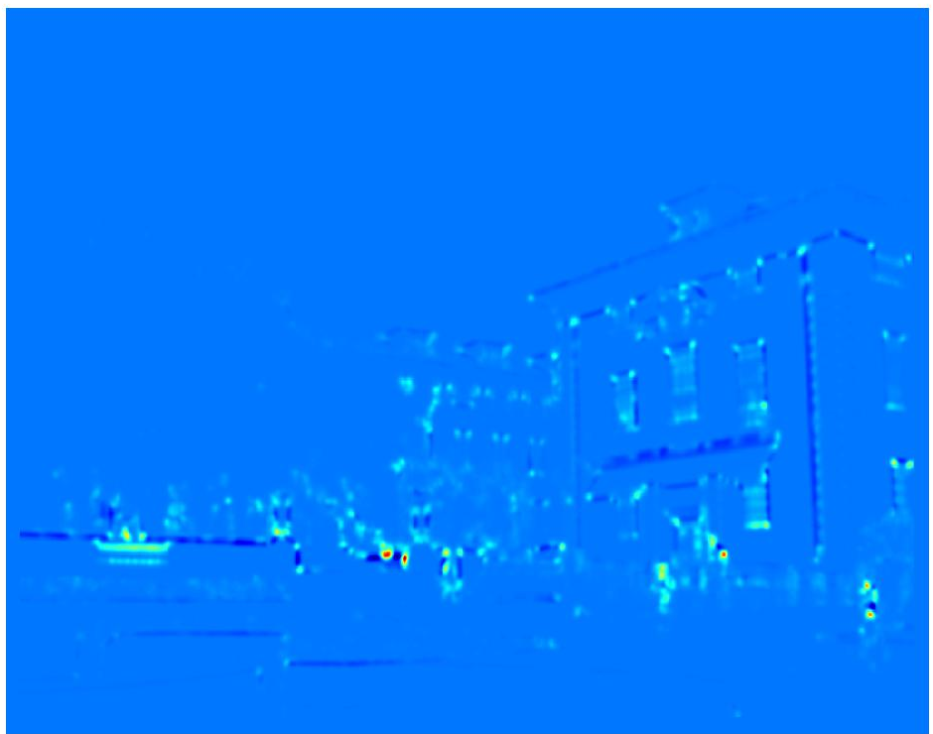
Example of Harris application
Compute corner response at every pixel.
Kristen Grauman

Slide 63
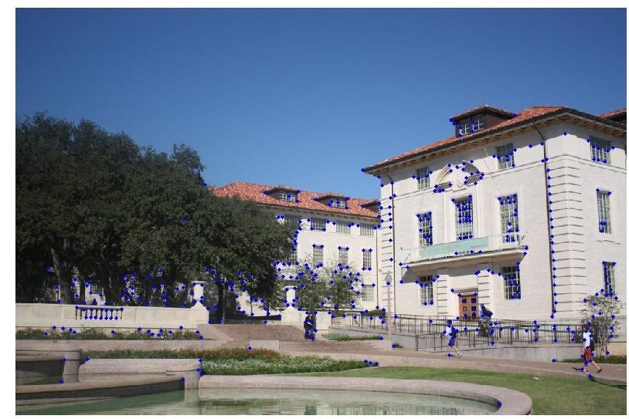
Example of Harris application
Kristen Grauman
Notes:
Only non-maxes exceeding average (thresholded)

Slide 64
Properties of the Harris corner detector
Rotation invariant?
Yes

Slide 65
Properties of the Harris corner detector
Rotation invariant?
Translation invariant?
Yes
Yes

Slide 66
Properties of the Harris corner detector
Rotation invariant?
Translation invariant?
Scale invariant?
Yes
Yes
No
All points will be classified as edges
Corner !

Slide 67
Summary
Image warping to create mosaic, given homography
Interest point detection
Harris corner detector
Next time:
Laplacian of Gaussian, automatic scale selection

